Slide 1
School of Engineering Year 4: 2023-24 Programming with Data EL4013 NYC TAXI DATA ANALYSIS AND TRIP DURATION PREDICTION
Muhammed Murshid PP

Slide 2
Abstract
In order to forecast journey times, I examined the NYC Yellow Taxi Ride Data for January 2016 that I downloaded from NYC.gov for this research.
The data used in the attached datasets were collected and provided to the NYC Taxi and Limousine Commission (TLC) by technology providers authorized under the Taxicab & Livery Passenger Enhancement Programs (TPEP/LPEP)(www.nyc.gov, n.d.).
The preprocessing of the dataset involved utilising winsorization percentiles to remove outliers and dummy encoding for categorical characteristics.
For prediction, three machine learning models were used: XGBoost Regressor, Random Forest Regressor, and Multiple Linear Regression.
The models were compared using performance indicators such as Variance, RMS Log Error, and RMS Error.
The results of the investigation showed that the XGBoost Regressor performed better in terms of resilience and accuracy than the other models.
The results demonstrate the usefulness of ensemble models in this forecasting job and advance our understanding of the factors determining the length of taxi trips.

Slide 3
Dataset
In this notebook, I have utilised Yellow Taxi Trip Record Data from January of 2016, gathered by TLC Trip Record Data.
The data set is a parquet file format.
VendorID: A code designating the supplier of the document. 1 = Innovative Mobile Technologies, Inc. 2 = VeriFone Inc.
tpep_pickup_datetime : The time and date that the journey was first recorded by the metre.
tpep_dropoff_datetime : The time and date when the trip was stopped by the metre.
passenger_count : The number of people the taxi drivers reported being in the car.
trip_distance : The taximeter's recorded elapsed trip distance in miles.
RatecodeID : The last rate code in use at the conclusion of the journey. 1= Standard rate, 2=JFK, 3=Newark, 4=Nassau or Westchester, 5=Negotiated fare, 6=Group ride.

Slide 4
Dataset
store_and_fwd_flag : This function offers a flag that is kept in the cab memory prior to transmitting the provided information in case of any problems. Y = sent to the provider after being saved in the system. N = not kept in the memory of the taxi
PULocationID : The location ID for pickup. The mentioned nyc website has the dictionaries for each of the 256 places.
DOLocationID : The mentioned nyc website has the dictionaries for each of the 256 places.
payment_type : A number that indicates the mode of payment.Credit card(1), cash(2), no fee(3), dispute(4), unknown(5), and cancelled trip(6).
fare_amount : The meter's computation of the fare based on time and distance.
extra : Unspecified additional costs and fees. As of right now, this only applies to the nighttime and rush hour fees of $1 and 0.5.
tip_amount : immediately added upon credit card payment; mta_tax: a $0.50 automatically charged based on the metered rate.

Slide 5
Dataset
tolls_amount : The total tolls paid for the journey.
Improvement surcharge : An assessed trip fee of $0.30 at the flag drop.
total_amount : The total amount that the traveller will be charged.
congestion_surcharge : The total amount collected for the New York State congestion surcharge during a trip.
airport fee : Only at LaGuardia and John F. Kennedy Airports is there a $1.25 pickup cost.

Slide 6
Data Preparation and Cleaning
Elimination of Duplicates: Duplicate records were found in the dataset and eliminated to protect data integrity and prevent skewing analysis results.
Dealing with Null Values : 'congestion_surcharge' and 'airport_fee' columns had no records, according to an investigation into the existence of null values. These columns were eliminated because they provided no useful data for analysis.
Date Conversion: Date columns were converted to datetime format for handling and analytical uniformity.
Feature Deletion : From the datetime columns, pertinent temporal information like month, weekday, and hour were extracted. To improve the dataset, more features were derived, such as average speed and trip duration.
Analysis of Outliers: To handle outliers in pertinent features and ensure robustness in further analysis, winsorization percentiles were applied.
Data Coherence Verification: examined for overall consistency in data in order to spot any deviations or abnormalities.

Slide 7
Data Preparation and Cleaning
Encountered Problems:
Duplicate records in the dataset required to be removed in order to avoid inaccurate analysis.
A few columns ('congestion_surcharge' and 'airport_fee') were dropped for simplicity because no values were recorded for them.
Winsorization may be required for robust outlier handling if preliminary analysis identified possible outliers.
Together, these actions attempted to clean the data, deal with any incorrect or missing values, and guarantee that the dataset was ready for further analysis and modelling.

Slide 8
Research Questions
Is it possible to forecast how long a taxi ride will take in New York City depending on the time of speed, Distance, day, day of the week, month, and other pertinent details?
Furthermore, for the top-performing model with the highest predictive accuracy, what is the difference between the actual and predictesd durations?"
These inquiries are undoubtedly presented from a business standpoint, demonstrating a pragmatic and strategic interest in maximising taxi services.
Businesses can increase operational efficiency and adjust to changing demand patterns thanks to this knowledge.
Taxi businesses may improve overall service quality, cut down on waiting times, and optimise operations by having the capacity to estimate journey durations based on important characteristics.Improved resource management and customer service are positively impacted by more precise predictions.

Slide 9
Methods
Data analysis:
The data was analysed using the boxplot(), describe(), and unique() methods to provide insights into its distribution and highlight any problems.
In order to ensure data quality and reliability in subsequent analysis and modelling, boxplots were used to visualise the spread and identify outliers,
describe() provided summary statistics for key features, and unique() helped detect unrealistic and invalid values, such as incorrect Ratecode ID and passenger count.
Winzorization for Managing Outliers and Dummy Encoding for Categorical Data:
By capping extreme outliers, winzorization ensures a more robust analysis by addressing the problem of unusually large trip distance numbers.
In the absence of a natural ordinal relationship, dummy encoding was used to effectively represent categorical data, such as pickup time and day of the week, without introducing artificial ordering.

Slide 10
Methods
Machine learning Models:
Explaining Random Forest Regressor, XGBoost Regressor, and Multiple Linear Regression To forecast the length of cab trips, three different regression models were used:
Multiple Linear Regression, Random Forest Regressor, and XGBoost Regressor.
Models Evaluation:
Various facets of the dataset's patterns are catered to by the distinct strengths and complexities offered by each model.
Values closer to 1 indicate a better fit. R2, also known as the coefficient of determination, measures the percentage of variance in the dependent variable explained by the regression model.Lower values indicate better predictive performance.
RMSE, or Root Mean Squared Error, measures the average magnitude of prediction mistakes and offers a succinct indicator of model accuracy.
When taken as a whole, these metrics provide a clear and insightful assessment of how well a regression model captures and predicts the underlying patterns in the data.

Slide 11
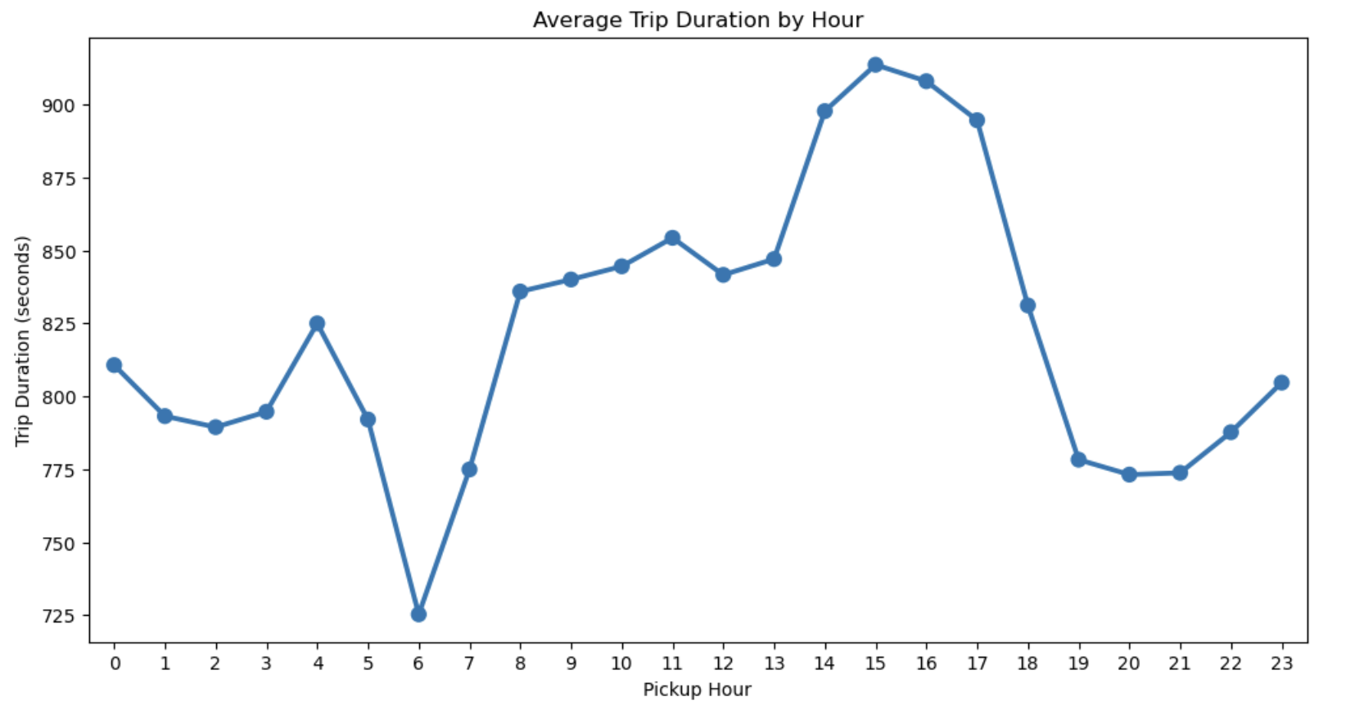
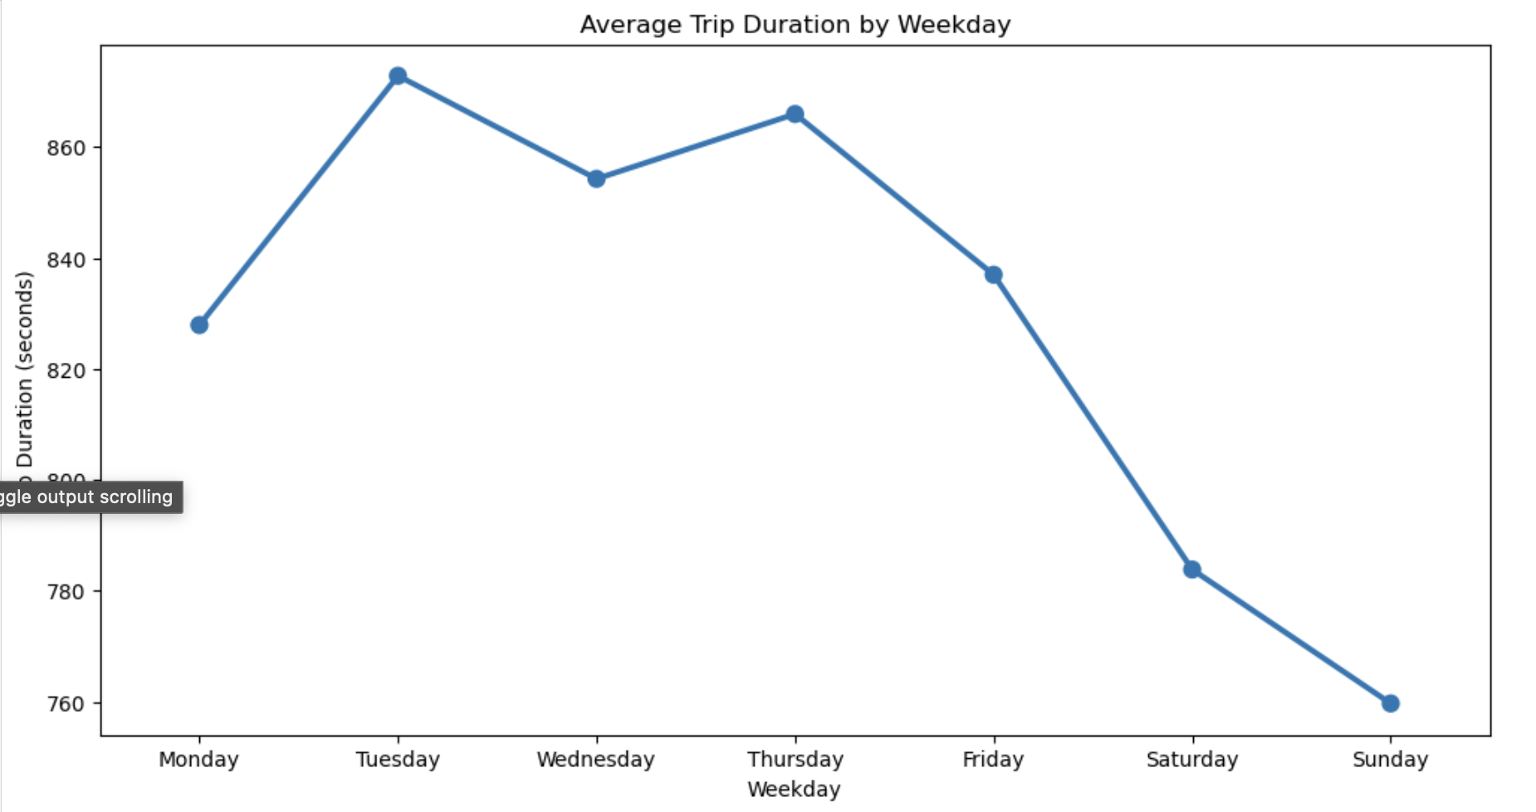
Findings
The travel duration by hour is represented by a line graph that shows a steady decline starting at 5 am, peaking at 6 am, and then a noticeable rise from 6 am to 8 am. The line graph showing the length of trips by weekday shows that Tuesdays have the longest trips, which gradually get shorter from Thursday to Sunday.

Slide 12
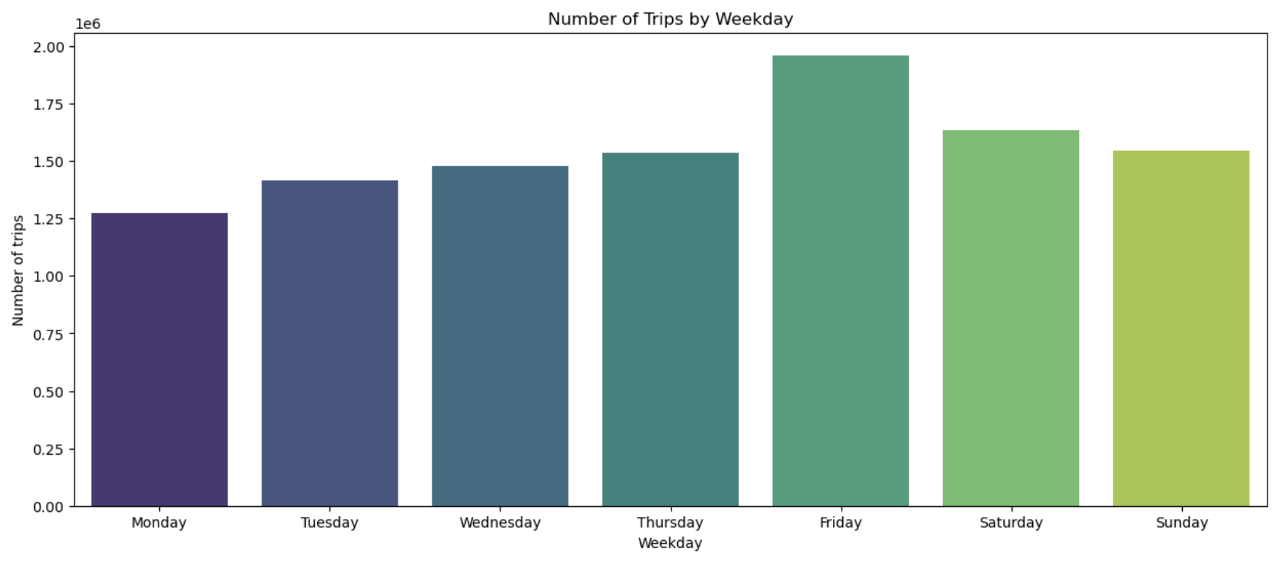
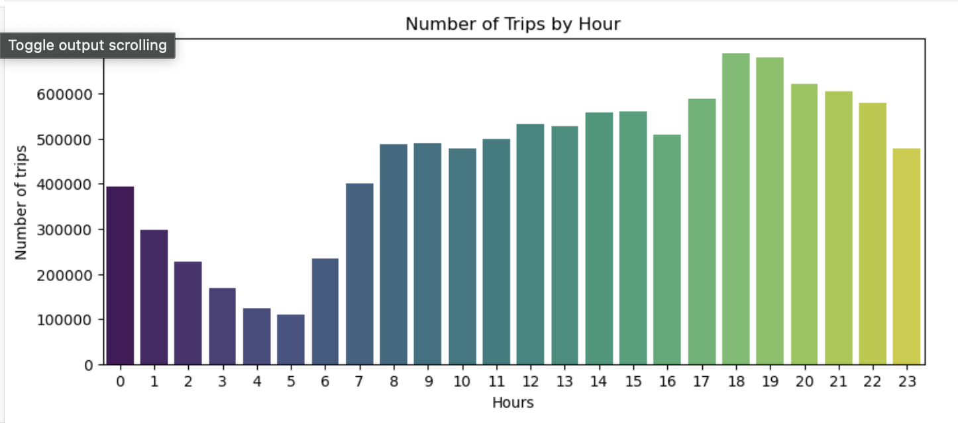
Findings
According to the bar chart, Friday has the most travels, indicating a high level of demand that may be related to the end of the workweek and an increase in social events. In addition, the bar chart showing the number of trips per hour shows a sharp surge in demand during the evening rush hours at 4 and 5 a.m. and a sharp decline in rides at 6 and 7 p.m.

Slide 13
Findings
Travel times follow a unique pattern during the day. Interestingly, durations start to progressively decline around 5 am and peak at 6 am.
Then there's a big spike between 6 and 8 am, indicating that there's more demand in the morning.
Trip times begin to gradually decrease around 7 p.m. and peak late at night.
stronger journey durations on Tuesdays stand out, suggesting either unusual patterns or possibly stronger demand on this particular day.
Travel times taper off from Thursday to Sunday, in line with usual differences in travel patterns on weekdays and weekends.
The number of rides peaks on Fridays, indicating a possible correlation between the conclusion of the workweek and increased demand.
Weekend ride counts may be a sign of more people engaging in leisure or recreational activities.

Slide 14
Conclusions
Research Question: Is it possible to Predict the duration of a taxi ride using a variety of factors?
In conclusion, different machine learning models showed differing degrees of effectiveness in forecasting the length of taxi trips. These models included Multiple Linear Regression, Random Forest Regressor, and XGBoost Regressor. The model that performed the best was the Random Forest Regressor, which demonstrated exceptional accuracy and resilience in capturing the intricacies of travel time.
For the optimal model, what is the difference in durations between real and predicted?
In conclusion, a thorough analysis was conducted on the discrepancy between the actual and projected durations for the Random Forest Regressor, the model that performed the best. The knowledge gathered from this analysis helps to clarify how well the model represents the nuances of travel times, setting the stage for future adjustments and advancements in predictive modelling.

Slide 15
Limitations
The analysis was limited to yellow taxi data for January 2016, which means it might not apply to other months or years. Additionally, the focus was solely on yellow taxi data without incorporating trip data from other taxi sources or Green Taxi Trip, For-Hire Vehicle Trip Records from New York City.
Finally, there was a possibility of bias resulting from differences in the quality and completeness of the data.
Adding historical years to the study and taking other influences into account could make the results more reliable and useful.

Slide 16
Future Works
Extending Temporal Scope: Yearly data should be taken into account for a more thorough examination and comprehension of long-term changes in taxi riding patterns.
Advanced Feature Selection: Using strict feature selection techniques to find and include just the most significant variables in the predictive models, such as hypothesis testing (p-value analysis).
Time Series Analysis: Using time series analysis methods to better forecast outcomes and shed light on changing patterns by capturing and modelling temporal interdependence in the data.
Hyperparameter tuning: Using strategies for optimising model parameters to improve generalizability and predictive performance.
Predictive Extensions: Increasing the scope of predictive skills to encompass new goals, such projecting the number of possible trips and trip totals, which can offer important information for business scalability.
Including External Elements:Weather data for particular places is included to improve prediction realism and provide more detailed insights for taxi service operators to adjust to changing conditions.
Business Impact: Stressing how these study extensions may benefit taxi vendors and businesses by facilitating improved planning, scalability, and strategic decision-making.

Slide 17
References
TLC Trip Record Data :
www.nyc.gov. (n.d.). TLC Trip Record Data - TLC. [online] Available at: https://www.nyc.gov/site/tlc/about/tlc-trip-record-data.page.
scikit-learn documentations:
scikit-learn developers (2019). sklearn.linear_model.LinearRegression — scikit-learn 0.22 documentation. [online] Scikit-learn.org. Available at: https://scikit-learn.org/stable/modules/generated/sklearn.linear_model.LinearRegression.html.
kaggle.com. (n.d.). NYC Taxi Trip Duration Prediction. [online] Available at: https://www.kaggle.com/code/nitin194/nyc-taxi-trip-duration-prediction#Univariate-Analysis [Accessed 18 Dec. 2023].
‌

